Slide 1
Сonsciousness, Mind, Soul, Memory
How these concepts are connected?

Slide 2
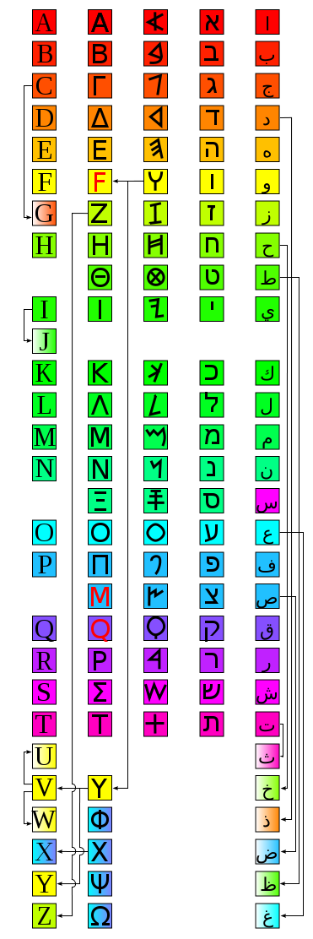

Slide 3
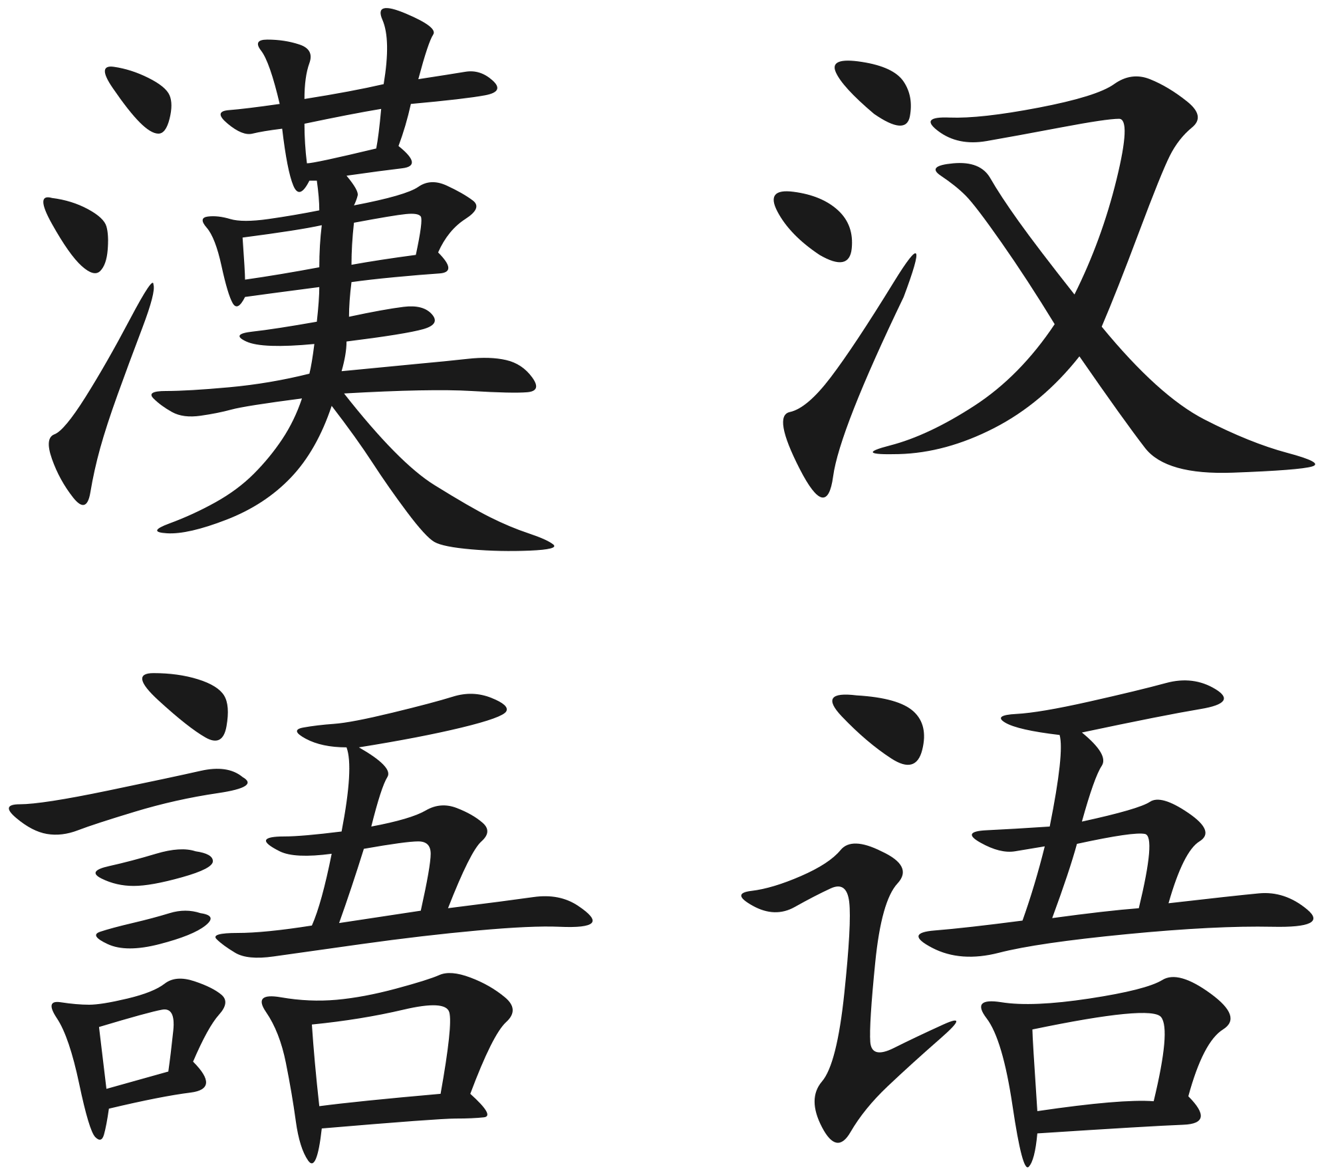

Slide 4


Slide 5


Slide 6
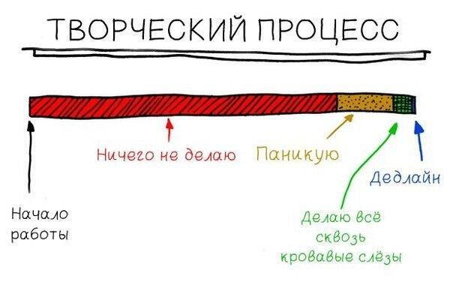
Art process

